Slide 1



Problem Solving in Python
Presented by

Slide 2
Workshop Description
This workshop will cover/strengthen the programming concepts using a series of problems - we will solve them in Python using a website called https://open.kattis.com So, come with a open mind, ready to think & be ready to learn by trial & error! We will start with very simple problems and build the confidence level & slowly increase the complexity of problems. Visit Google slides @ https://bit.ly/kattis-python for details.

Slide 3
Few resources from the web!
There are tons of resources in the web to learn / lookup information about Python. Here are a few that you may want to review.
Learn Python 3 - CodeAcademy
W3schools - Python Tutorial
Learn Python in 10 minutes
Learn Python - Tutorial for Beginners

Slide 4
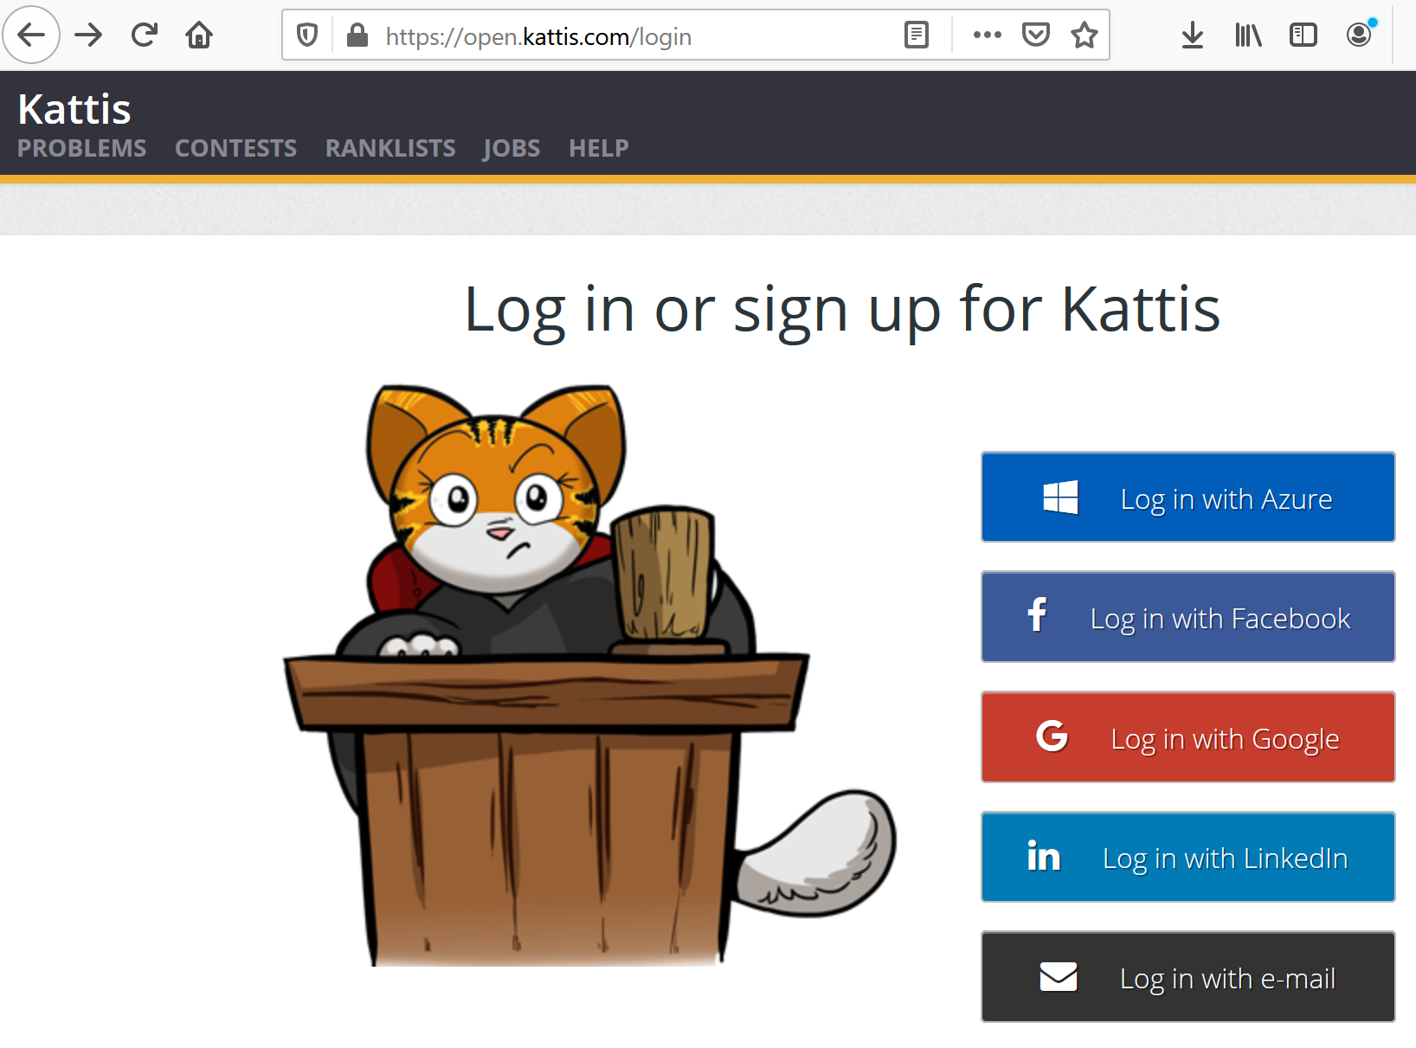
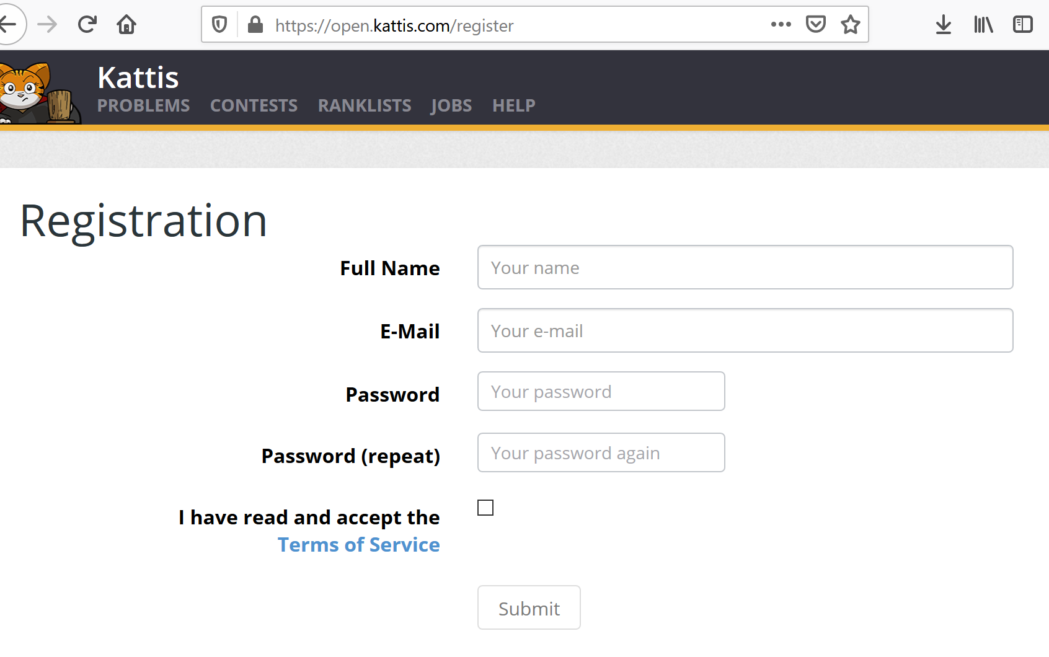
Setup
Setup a FREE account @ open.kattis.com/login OR open.kattis.com/register

Slide 5
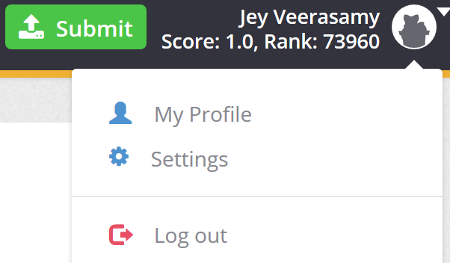
Set preferred programming language...
Click on the top-right corner, expand the menu, click on Settings, select the country, Subdivision and University. Also, update the timezone & default programming language as well.

Slide 6
Requirements - any of these will do!
Online Python Editor - https://repl.it/languages/python3 (NO installation needed! You do need to create a free online account to store your programs)
Anaconda Navigator - https://www.anaconda.com/products/individual
Pycharm Community Edition - https://www.jetbrains.com/pycharm/download/#section=windows

Slide 7
Let us get started!
We are ready to do our first exercise.
https://open.kattis.com/problems?order=problem_difficulty lists the problems in increasing level of difficulty. We will be doing several of these problems in the workshop.
We encourage you to work on additional problems for your own & increase your score, but please … do not ask any one to code for you or copy from someone & cheat yourself out of this good learning experience!
So, be honest to yourself and have fun!

Slide 8
Problem #1 - Hello World
https://open.kattis.com/problems/hello
Problem Description: Output should contain one line, containing the string “Hello World!”.

Slide 9
Solution #1 - Hello World
https://open.kattis.com/problems/hello
print("Hello World!")

Slide 10
Session #1
Variables - A container (memory location) for storing some data
Data Types - The type of data being stored in a variable
Expressions - Combinations of values or data, and operators, that can be evaluated to some value

Slide 11
Problem #2 - R2
https://open.kattis.com/problems/r2
Problem Statement - The number 𝑆 is called the mean of two numbers 𝑅1 and 𝑅2 if 𝑆 is equal to (𝑅1+𝑅2)/2. Mirko’s birthday present for Slavko was two integers 𝑅1 and 𝑅2. Slavko promptly calculated their mean which also happened to be an integer but then lost 𝑅2! Help Slavko restore 𝑅2.
Explanation - (R1 + R2) / 2 = S
We are given R1 and S, we need to find R2
How? We use R2 = (S * 2) - R1

Slide 12
Solution #2 - R2
https://open.kattis.com/problems/r2
(r1, s) = input().split(" ") r1 = int(r1) s = int(s) r2 = s * 2 - r1 print(r2)

Slide 13
Problem #3 - Autori
https://open.kattis.com/problems/autori
Explanation - Given an input like ‘Knuth-Morris-Pratt’
Print the first character of each word
Output = KMP

Slide 14
Solution #3 - Autori
https://open.kattis.com/problems/autori
names = input() abbrev = "" for name in names.split("-"): abbrev = abbrev + name[0] print(abbrev)

Slide 15
Session #1 contd.
Comments - Lines that are ignored during the execution of the program
Operator Precedence:
() | Parentheses
** | Exponent or Power
/, *, //, % | Multiplication, Division, Modulus
+, - | Addition, Subtraction
==, !=, >=, >, <=, < | Comparison Operators

Slide 16
Practice Problem #1 - Remainder
Given 2 integers, A and B, how would you find the remainder when A is divided by B?
Example: A = 5 and B = 2; the remainder of 5/2 is 1

Slide 17
Practice Problem #1 Solution - Remainder
Given 2 integers, A and B, how would you find the remainder when A is divided by B?
(a, b) = input().split(" ") a = int(a) b = int(b) remainder = a % b print (remainder)

Slide 18
Session #2
Conditional statements: execute (or don’t execute) some statements based on some condition(s)
if <expr>: <statement(s)>
if <expr>: <statement(s)> else: <statement(s)>

Slide 19
Session #2 contd.
if <expr>: <statement(s)> elif <expr>: <statement(s)> else: <statement(s)>

Slide 20
Problem #4 - Take Two Stones
https://open.kattis.com/problems/twostones
Explanation - Given an input number (the number of stones)
Is this input number even or odd

Slide 21
Solution #4 - Take Two Stones
https://open.kattis.com/problems/twostones
num = int(input()) if(num % 2 == 0): print('Bob') else: print('Alice')

Slide 22
Problem #5 - Quadrant Selection
https://open.kattis.com/problems/quadrant
Explanation - Given x and y coordinates of a point, print which quadrant of a graph the point lies in
X and Y will never be 0

Slide 23
Solution #5 - Quadrant Selection
https://open.kattis.com/problems/quadrant
x = int(input()) y = int(input()) if(x > 0 and y > 0): print(1) elif(x < 0 and y > 0): print(2) elif(x < 0 and y < 0): print(3) else: print(4)

Slide 24
Problem #6 - Python If-Else
https://www.hackerrank.com/challenges/py-if-else/problem
Given an integer, n, perform the following conditional actions:
If n is odd, print Weird
If n is even and in the inclusive range of 2 to 5, print Not Weird
If n is even and in the inclusive range of 6 to 20, print Weird
If n is even and greater than 20, print Not Weird

Slide 25
Solution #6 - Python If-Else
https://www.hackerrank.com/challenges/py-if-else/problem
n = int(input()) if(n % 2 != 0): print("Weird") elif(n >= 2 and n <= 5): print("Not Weird") elif(n >=6 and n <= 20): print("Weird") else: print("Not Weird")

Slide 26
Problem #7 - Spavanac
https://open.kattis.com/problems/spavanac
Explanation - Given H (hours) and M (minutes), subtract 45 minutes

Slide 27
Solution #7 - Spavanac
https://open.kattis.com/problems/spavanac
(h, m) = input().split(" ") h = int(h) m = int(m) if(m >= 45): m = m - 45 else: m = 60 - (45 - m) if(h != 0): h = h - 1 else: h = 23 print(h , " " , m)

Slide 28
Problem #8 - Uppercase or Lowercase
Explanation - Given a single character, check whether it is uppercase, lowercase, or not an alphabet

Slide 29
Solution #8 - Uppercase or Lowercase
char = input() asciiChar = ord(char)
if(asciiChar >= 97 and asciiChar <= 122): print(chr(asciiChar), "is Lowercase") elif(asciiChar >= 65 and asciiChar <= 90): print(chr(asciiChar), "is Uppercase") else: print(chr(asciiChar), "is not an alphabet")

Slide 30
Problem #9 - Check Attendance
Explanation - Given the total number of classes for a subject, and the number of classes attended by a student, check whether the attendance percentage is greater than 70.

Slide 31
Solution #9 - Check Attendance
(attended, total) = input().split() total = int(total) attended = int(attended) percentage = attended / total * 100 if(attended > total): print("Invalid Data") elif(percentage > 70): print("Sufficient Attendance") else: print("Insufficient Attendance")

Slide 32
Problem #10 - Calculate Electricity Bill
Explanation - Given the number of units used, calculate the total bill amount
1 to 100 units – Rs. 10/unit
101 to 200 units – Rs. 15/unit
201 to 300 units – Rs. 20/unit
above 300 units – Rs. 25/unit

Slide 33
Solution #10 - Calculate Electricity Bill
units = float(input()) total = 0.0 if(units >= 1 and units <= 100): total += (units * 10) elif(units <= 200): total += (units - 100) * 15 + (10 * 100) elif(units <= 300): total += (units - 200) * 20 + 100 * 15 + 100 * 10 elif(units > 300): total += (units - 300) * 25 + 100 * 20 + 100 * 15 + 100 * 10 else: print("Invalid Data") print(total)

Slide 34
Practice Problem #2 - Movie Ticket
Given the rating of a movie ‘G’, ‘PG’, ‘R’, and the age of a person 1 - 100, print whether the person is allowed to book a ticket for that movie
G → Age 1 and above
PG → Age 13 and above
R → Age 18 and above
Example: Rating = PG, Age = 12; Output = Not Allowed

Slide 35
Practice Problem #2 Solution - Movie Ticket
rating = input() age = int(input())
if(rating == 'R' and age < 18): print('Not Allowed') elif(rating == 'PG' and age < 13): print('Not Allowed') else: print('Allowed')

Slide 36
Session #3
While loop - Execute some statements as long as some condition is true
For loop - Iterate over a sequence, or each item in a range
Break - Stop loop execution (‘break’ out of the loop)
Continue - Move on to the next loop iteration
Pass - Statement that does nothing

Slide 37
Problem #11 - Stuck In A Time Loop
https://open.kattis.com/problems/timeloop
Explanation - Given an integer N, print every number from 1 to N followed by ‘Abracadabra’

Slide 38
Solution #11 - Stuck In A Time Loop
https://open.kattis.com/problems/timeloop
n = int(input()) for i in range(1, n + 1): print(i , "Abracadabra")

Slide 39
Problem #12 - Hissing Microphone
https://open.kattis.com/problems/hissingmicrophone
Explanation - Given an input string, check whether ‘s’ occurs consecutively

Slide 40
Solution #12 - Hissing Microphone
https://open.kattis.com/problems/hissingmicrophone
string = input() flag = False for index in range(len(string) - 1): if(string[index] == 's' and string[index + 1] == 's'): print('hiss') flag = True break if(not flag): print('no hiss')

Slide 41
Problem #13 - Cold-puter Science
https://open.kattis.com/problems/cold
Explanation - Given ‘n’ numbers, count how many are less than 0

Slide 42
Solution #13 - Cold-puter Science
https://open.kattis.com/problems/cold
num = int(input()) count = 0 for i in input().split(): temp = int(i) if(temp < 0): count += 1 print(count)

Slide 43
Problem #14 - Tarifa
https://open.kattis.com/problems/tarifa

Slide 44
Solution #14 - Tarifa
https://open.kattis.com/problems/tarifa
maximum = int(input()) count = int(input()) final = maximum for i in range(count): usage = int(input()) final -= usage final += maximum print(final)

Slide 45
Session #4
Iteration continued

Slide 46
Problem #15 - Line Them Up
https://open.kattis.com/problems/lineup
Explanation - Check whether the input strings are arranged in increasing order, decreasing order, or neither

Slide 47
Solution #15 - Line Them Up
https://open.kattis.com/problems/lineup
count = int(input()) previous = "" increasingFlag = True decreasingFlag = True for _ in range(count): current = input() if(previous != ""): if(current < previous): increasingFlag = False

Slide 48
Solution #15 - Line Them Up contd.
if(current > previous): decreasingFlag = False previous = current if(increasingFlag): print("INCREASING") elif(decreasingFlag): print("DECREASING") else: print("NEITHER")

Slide 49
Problem #16 - Cryptographer’s Conundrum
https://open.kattis.com/problems/conundrum
Explanation - Given an input string ‘s’, check how many characters have to be replaced so that ‘s’ only contains ‘PER’ repeated some number of times

Slide 50
Solution #16 - Cryptographer’s Conundrum
https://open.kattis.com/problems/conundrum
cipher = input() replacement = "PER" replacementIndex = 0 count = 0 for index in range(len(cipher)): if(cipher[index] != replacement[replacementIndex]): count+=1 replacementIndex = (replacementIndex + 1) % 3 print(count)

Slide 51
Problem #17 - Apaxiaaaaaaaaaaaans!
https://open.kattis.com/problems/apaxiaaans
Explanation - Given an input string ‘s’, if a character occurs 2 or more times consecutively, replace it with a single occurrence of that character

Slide 52
Solution #17 - Apaxiaaaaaaaaaaaans!
https://open.kattis.com/problems/apaxiaaans
string = input() result = string[0] for index in range(1, len(string)): if(string[index] == result[-1]): continue result += string[index] print(result)

Slide 53
Session #5
Iteration continued

Slide 54
Problem #18 - FizzBuzz
https://open.kattis.com/problems/fizzbuzz

Slide 55
Solution #18 - FizzBuzz
https://open.kattis.com/problems/fizzbuzz
(x, y, n) = input().split() x = int(x) y = int(y) n = int(n) for i in range(1, n + 1): if(i % x == 0 and i % y == 0): print("FizzBuzz") elif(i % x == 0): print("Fizz") elif(i % y == 0): print("Buzz") else: print(i)

Slide 56
Problem #19 - Harshad Numbers
https://open.kattis.com/problems/harshadnumbers
Explanation - Harshad Number : a number which is divisible by the sum of its digits. Eg: 24 is divisible by 6 (2 + 4 = 6)
Given a number n as input, find the smallest Harshad Number greater than or equal to n

Slide 57
Solution #19 - Harshad Numbers
https://open.kattis.com/problems/harshadnumbers
num = int(input()) while(True): copy = num digitSum = 0 while(copy != 0): digit = copy % 10 digitSum += digit copy = copy // 10 if(num % digitSum == 0): break num += 1 print(num)

Slide 58
Problem #20 - Trik
https://open.kattis.com/problems/trik

Slide 59
Solution #20 - Trik
https://open.kattis.com/problems/trik
moves = input() position = 1 for move in moves: if move == 'A': if position == 1: position = 2 elif position == 2: position = 1 if move == 'B': if position == 2: position = 3 elif position == 3: position = 2 if move == 'C': if position == 1: position = 3 elif position == 3: position = 1 print(position)

Slide 60
Problem #21 - Filip
https://open.kattis.com/problems/filip
Explanation - Given 2 numbers, reverse both numbers and check which of the reversed numbers is larger

Slide 61
Solution #21 - Filip
https://open.kattis.com/problems/filip
(x, y) = input().split() revX = "" revY = "" for char in x: revX = char + revX for char in y: revY = char + revY if(revX > revY): print(revX) else: print(revY)

Slide 62
Problem #22 - Oddities
https://open.kattis.com/problems/oddities
Explanation - Given n numbers, print whether each number is even or odd

Slide 63
Solution #22 - Oddities
https://open.kattis.com/problems/oddities
n = int(input()) outputString = "" for i in range(n): num = int(input()) if(num % 2 == 0): newString = str(num) + " is even \n" else: newString = str(num) + " is odd \n" outputString += newString print(outputString)

Slide 64
Practice Problem #3 - Soda Slurper
https://open.kattis.com/problems/sodaslurper

Slide 65
Practice Problem #3 Solution - Soda Slurper
https://open.kattis.com/problems/sodaslurper
(e, f, c) = input().split() e = int(e) f = int(f) c = int(c) count = 0 total = e + f while total > 0: bottles = total // c count += bottles total = total - (bottles * c) + bottles if(bottles == 0): break print(count)

Slide 66
Session #6
Functions and Methods
Named sequence of statements that performs some task
Code reusability and modularity
May be user-defined or built-in
Method uses dot operator
Functions typically do not modify the data
Methods may modify the data
Both are not executed until they are ‘called’
Parameters - placeholders in function definition
Arguments - actual values that get passed to the function

Slide 67
Problem #23 - Reversed Binary Numbers
https://open.kattis.com/problems/reversebinary
Explanation - Given a number n
Convert it into binary form
Reverse the binary form
Convert it back into decimal form and print it

Slide 68
Solution #23 - Reversed Binary Numbers
https://open.kattis.com/problems/reversebinary
def getBinaryRepresentation(number): result = bin(number) result = result.replace("0b", "") return result def getDecimalRepresentation(number): result = int(number, 2) return result def reverseString(data): result = "" for char in data: result = char + result return result n = int(input()) binary = getBinaryRepresentation(n) binary = reverseString(binary) print(getDecimalRepresentation(binary))

Slide 69
Problem #24 - Basic Calculator
Explanation - Given 2 numbers x and y, and an operator o
Apply the operator to the 2 numbers
Operator may be +, -, %, /, *

Slide 70
Solution #24 - Basic Calculator
def applyOperator(x, y, o): if(o == '+'): return x + y elif(o == '-'): return x - y elif(o == '/'): return x / y elif(o == '*'): return x * y elif(o == '%'): return x % y

Slide 71
Solution #24 - Basic Calculator contd.
def validateOperator(o): if(o == '+' or o == '-' or o == '/' or o == '%' or o == '*'): return True return False
(x, y, o) = input().split() x = int(x) y = int(y) if(validateOperator(o)): print(applyOperator(x, y, o)) else: print("Invalid Operator")

Slide 72
2nd June, 2021 - Session #7
Functions continued

Slide 73
Problem #25 - Hanging Out On The Terrace
https://open.kattis.com/problems/hangingout

Slide 74
Solution #25 - Hanging Out On The Terrace
https://open.kattis.com/problems/hangingout
def checkTerrace(action, number, maximum, current): result = 0 if(action == 'enter'): if(current + int(number) > maximum): result = 1 else: current += int(number) else: current -= int(number) return (result, current)

Slide 75
Solution #25 - Hanging Out On The Terrace contd.
(maximum, count) = input().split() maximum = int(maximum) count = int(count) result = 0 current = 0 for index in range(count): (action, number) = input().split() (leaveCount, current) = checkTerrace(action, number, maximum, current) result += leaveCount print(result)

Slide 76
Problem #26 - Nasty Hacks
https://open.kattis.com/problems/nastyhacks
Explanation - Given 3 numbers r, e, and c;
Check whether r is greater than, less than, or equal to (e - c)

Slide 77
Solution #26 - Nasty Hacks
https://open.kattis.com/problems/nastyhacks
def checkRevenue(r, e, c): if(r == (e - c)): return "does not matter\n" if(r > (e - c)): return "do not advertise\n" if(r < (e - c)): return "advertise\n" count = int(input()) result = "" for _ in range(count): (r, e, c) = input().split() r = int(r) e = int(e) c = int(c) result = result + checkRevenue(r, e, c) print(result.rstrip(result[-1]))

Slide 78
Problem #27 - Leap Year
https://www.hackerrank.com/challenges/write-a-function/problem
Explanation - Given a year as input, check whether it is a leap year or not

Slide 79
Solution #27 - Leap Year
https://www.hackerrank.com/challenges/write-a-function/problem
def is_leap(year): if(year % 4 == 0): if(year % 100 == 0): if(year % 400 == 0): return True return False return True return False year = int(input()) print(is_leap(year))

Slide 80
Practice Problem #4 - One Chicken Per Person!
https://open.kattis.com/problems/onechicken

Slide 81
Practice Problem #4 Solution - One Chicken Per Person!
https://open.kattis.com/problems/onechicken
def insufficient(value): if(value > 1): output = "Dr. Chaz needs " + str(value) + " more pieces of chicken!" else: output = "Dr. Chaz needs " + str(value) + " more piece of chicken!” print(output) def sufficient(value): if(value > 1): output = "Dr. Chaz will have " + str(value) + " pieces of chicken left over!" else: output = "Dr. Chaz will have " + str(value) + " piece of chicken left over!" print(output) (m, n) = input().split() m = int(m) n = int(n) if(m > n): insufficient(m - n) else: sufficient(n - m)

Slide 82
Session #7 contd.
Recursion
Function ‘calling’ itself
Iterative vs. Recursive approach - typically, if a problem can be solved iteratively, it can be solved recursively as well (and vice versa)

Slide 83
Session #8
Recursion continued

Slide 84
Problem #28 - Factorial
Given a number n, print its factorial
n! = n * (n - 1) * (n - 2) … * 1
5! = 5 * 4 * 3 * 2 * 1

Slide 85
Solution #28 - Factorial
def findFactorial(num): if(num == 0): return 1 return num * findFactorial(num - 1) num = int(input()) print(findFactorial(num))

Slide 86
Problem #29 - Planina
https://open.kattis.com/problems/planina

Slide 87
Solution #29 - Planina
https://open.kattis.com/problems/planina
def displacementAlgo(iterations): if(iterations == 0): return 2 prevIteration = displacementAlgo(iterations - 1) return prevIteration + (prevIteration - 1) iterations = int(input()) result = displacementAlgo(iterations) print(result ** 2)

Slide 88
Problem #30 - Help a PhD Candidate Out!
https://open.kattis.com/problems/helpaphd
Explanation - There are 2 types of inputs:
a+b → in this case print the sum of a and b
P=NP → in this case, print skipped

Slide 89
Solution #30 - Help a PhD Candidate Out!
https://open.kattis.com/problems/helpaphd
def getResult(count): if(count == 0): return "" data = input() if(data == "P=NP"): return ('skipped\n') + getResult(count - 1) else: (a, b) = data.split("+") a = int(a) b = int(b) return str(a + b) + "\n" + getResult(count - 1) count = int(input()) print(getResult(count).rstrip("\n"))

Slide 90
Problem #31 - Reverse a String
Given a string as input, print its reverse

Slide 91
Solution #31 - Reverse a String
def reverseString(string, index): if(index == 0): return string[index] return string[index] + reverseString(string, index - 1) string = input() print(reverseString(string, len(string) - 1))

Slide 92
Practice Problem #5 - Last Factorial Digit
https://open.kattis.com/problems/lastfactorialdigit
Explanation - Given a number ‘N’, print the last digit of N!

Slide 93
Practice Problem #5 Solution - Last Factorial Digit
https://open.kattis.com/problems/lastfactorialdigit
def getFactorial(num): if(num == 0): return 1 return num * getFactorial(num - 1) count = int(input()) result = "" for _ in range(count): num = int(input()) fact = getFactorial(num) digit = fact % 10 result = result + str(digit) + "\n" print(result.rstrip("\n"))

Slide 94
Session #9
String methods and functions
Strings are immutable
String methods typically return new strings, they do not change the original string

Slide 95
Problem #32 - Reverse String
Given a string as input, reverse the string

Slide 96
Solution #32 - Reverse String
string = input() rev = string[::-1] print(rev)

Slide 97
Problem #33 - CamelCase
https://www.hackerrank.com/challenges/camelcase/problem
Explanation - Given a camel case string as input, count the number of words in the string

Slide 98
Solution #33 - CamelCase
https://www.hackerrank.com/challenges/camelcase/problem
def camelcase(s): count = 1 for char in s: if char.isupper(): count += 1 return count s = input() print(camelcase(s))

Slide 99
Problem #34 - Pangrams
https://www.hackerrank.com/challenges/pangrams/problem
Explanation - Given a string as input, check whether it contains every letter in the alphabet at least once

Slide 100
Solution #34 - Pangrams
https://www.hackerrank.com/challenges/pangrams/problem
def pangrams(s): s = s.lower() required = 'abcdefghijklmnopqrstuvwxyz' for alphabet in required: if s.find(alphabet) == -1: return 'not pangram' return 'pangram' string = input() print(pangrams(string))

Slide 101
Problem #35 - Simon Says
https://open.kattis.com/problems/simonsays

Slide 102
Solution #35 - Simon Says
https://open.kattis.com/problems/simonsays
count = int(input()) output = "" for _ in range(count): string = input() if string.startswith('Simon says'): output = output + string[10:] + "\n" print(output.rstrip("\n"))

Slide 103
Problem #36 - Most Frequent Character
Given a string, find the character occurring most frequently in the string
aaaaaabc = a

Slide 104
Solution #36 - Most Frequent Character
string = input() maxCount = 1 result = string[0] for char in string: count = string.count(char) if count > maxCount: result = char maxCount = count print(result)

Slide 105
Session #10
Sets
Unordered, unindexed, no duplicates allowed
Tuples
Ordered, indexed, allows duplicates, unchangeable

Slide 106
Problem #37 - Pangrams (repeated)
https://www.hackerrank.com/challenges/pangrams/problem

Slide 107
Solution #37 - Pangrams (repeated)
https://www.hackerrank.com/challenges/pangrams/problem
def pangrams(s): alphabets = set() s = s.lower() for char in s: if(char != ' '): alphabets.add(char) if(len(alphabets) < 26): return 'not pangram' return 'pangram'
print(pangrams(input()))

Slide 108
Problem #38 - Boat Parts
https://open.kattis.com/problems/boatparts

Slide 109
Solution #38 - Boat Parts
https://open.kattis.com/problems/boatparts
(num_parts, count) = input().split() num_parts = int(num_parts) count = int(count) parts = set() result = -1 for day in range(1, count + 1): part = input() parts.add(part) if(len(parts) == num_parts and result == -1): result = day if(len(parts) < num_parts): print('paradox avoided') else: print(result)

Slide 110
Problem #39 - I’ve Been Everywhere, Man
https://open.kattis.com/problems/everywhere
Explanation - Given a list of city names, count the number of distinct cities

Slide 111
Solution #39 - I’ve Been Everywhere, Man
https://open.kattis.com/problems/everywhere
testCaseCount = int(input()) result = "" for _ in range(testCaseCount): count = int(input()) cities = set() for _ in range(count): city = input() cities.add(city) result = result + str(len(cities)) + "\n" print(result.rstrip("\n"))

Slide 112
Problem #40 - No Duplicates
https://open.kattis.com/problems/nodup
Explanation - Given a string, check if any word is repeated in the string or not

Slide 113
Solution #40 - No Duplicates
https://open.kattis.com/problems/nodup
wordSet = set() repeatFlag = False string = input().split() for word in string : if word in wordSet: print('no') repeatFlag = True break wordSet.add(word) if(not repeatFlag): print('yes')

Slide 114
Problem #41 - Odd Man Out
https://open.kattis.com/problems/oddmanout
Explanation - Given n numbers as input, find the number that is not repeated

Slide 115
Solution #41 - Odd Man Out
https://open.kattis.com/problems/oddmanout
def findOddOneOut(guests) : guestSet = set() for guest in guests: if guest in guestSet: guestSet.remove(guest) else: guestSet.add(guest) return guestSet.pop() count = int(input()) result = "" for i in range(1, count + 1): number = int(input()) guests = input().split() result = result + "Case #" + str(i) + ": " + str(findOddOneOut(guests)) + "\n" print(result.rstrip("\n"))

Slide 116
Session #11
Lists
Ordered
Mutable / Changeable
Indexed
Duplicates allowed

Slide 117
Problem #42 - Pet
https://open.kattis.com/problems/pet
Explanation - Given 5 lists of numbers, find the list with the maximum sum

Slide 118
Solution #42 - Pet
https://open.kattis.com/problems/pet
points = list() maxSum = 0 winner = -1 for index in range(1, 6): total = 0 points = input().split() for point in points: total += int(point) if(total > maxSum): maxSum = total winner = index print(winner , " " , maxSum)

Slide 119
Problem #43 - Stopwatch
https://open.kattis.com/problems/stopwatch

Slide 120
Solution #43 - Stopwatch
https://open.kattis.com/problems/stopwatch
count = int(input()) times = [] for i in range(count): times.append(int(input())) result = 0 if count % 2 != 0 : print('still running') else: for i in range(1, len(times), 2): result += (times[i] - times[i - 1]) print(result)

Slide 121
Problem #44 - Jack-O’-Lantern Juxtaposition
https://open.kattis.com/problems/jackolanternjuxtaposition
Given a list of numbers, find the product of all the numbers

Slide 122
Solution #44 - Jack-O’-Lantern Juxtaposition
https://open.kattis.com/problems/jackolanternjuxtaposition
data = input().split() prod = 1 for num in data: prod *= int(num) print(prod)

Slide 123
Session #12
Lists continued

Slide 124
Problem #45 - Bijele
https://open.kattis.com/problems/bijele

Slide 125
Solution #45 - Bijele
https://open.kattis.com/problems/bijele
required = (1, 1, 2, 2, 2, 8) found = input().split() result = [] for i in range(len(found)): result.append(required[i] - int(found[i])) for r in result: print(str(r), end = " ")

Slide 126
Problem #46 - Odd Gnome
https://open.kattis.com/problems/oddgnome

Slide 127
Solution #46 - Odd Gnome
https://open.kattis.com/problems/oddgnome
def getPosition(data): for i in range(1, len(data)): if(data[i] != (data[i - 1] + 1)): return i + 1 return -1 result = "" count = int(input()) for _ in range(count): data = input().split() data = [int(d) for d in data] data.pop(0) result = result + str(getPosition(data)) + "\n" print(result.rstrip("\n"))

Slide 128
Problem #47 - Statistics
Given a list of numbers, print the minimum number, maximum number, and range

Slide 129
Solution #47 - Statistics
result = "" count = 1 while(True): data = input().split() if(len(data) == 0): break data = [int(d) for d in data] maximum = max(data) minimum = min(data) dataRange = maximum - minimum result = result + f"Case {count}: {minimum} {maximum} {dataRange}\n" count += 1 print(result.rstrip("\n"))

Slide 130
Problem #48 - Missing Numbers
https://open.kattis.com/problems/missingnumbers

Slide 131
Solution #48 - Missing Numbers
https://open.kattis.com/problems/missingnumbers
count = int(input()) nums = [] for _ in range(count): nums.append(int(input())) maximum = max(nums) flag = False for i in range(1, maximum + 1): if i not in nums: print(i) flag = True if(not flag): print('good job')

Slide 132
Problem #49 - Rotate List
Given a list and a number of steps ‘k’, rotate the list to the right by k steps

Slide 133
Solution #49 - Rotate List
nums = input().split() k = int(input()) k = k % len(nums) nums = [int(num) for num in nums] rotated = nums.copy() for i in range(len(nums)): index = (i + k) % len(nums) rotated[index] = nums[i] print(rotated)

Slide 134
Session #13
Lists continued

Slide 135
Problem #50 - Move Zeroes
Given a list of numbers, move all zeroes in the list to the end

Slide 136
Solution #50 - Move Zeroes
nums = input().split() nums = [int(n) for n in nums] counter = 0 for i,n in enumerate(nums): if n != 0: nums[counter] = n counter += 1 for i in range(counter, len(nums)): nums[i] = 0 print(nums)

Slide 137
Problem #51 - Palindrome
Given a list of letters, check whether the list forms a palindrome or not

Slide 138
Solution #51 - Palindrome
def checkPalindrome(letters): start = 0 end = len(letters) - 1 while(start < end): if letters[start] != letters[end]: return False start += 1 end -= 1 return True letters = input().split() print(checkPalindrome(letters))

Slide 139
Problem #52 - Duplicates
Given a list of numbers, check if any number is repeated in the list

Slide 140
Solution #52 - Duplicates
def checkDuplicate(nums): nums.sort() for i in range(1, len(nums)): if nums[i] == nums[i - 1]: return True return False numbers = input().split() numbers = [int(n) for n in numbers] print(checkDuplicate(numbers))

Slide 141
Problem #53 - Two Sum
Given a list of n numbers and a target t, return true if two numbers in the list can sum up to t, and false otherwise
Assume the same number can be used many times

Slide 142
Solution #53 - Two Sum
def twoSum(nums, t): numSet = set() for num in nums: numSet.add(num) for num in nums: rem = t - num if rem in numSet: return True return False nums = input().split() t = int(input()) nums = [int(num) for num in nums] print(twoSum(nums, t))

Slide 143
Session #14
Dictionaries → {}
Key-Value pairs
All keys must be unique
Indexed by keys
Used for fast access to values

Slide 144
Problem #54 - Two Sum
Given a list of numbers and a target t, return True if any 2 numbers can sum up to t
Assume that you cannot use the same element twice

Slide 145
Solution #54 - Two Sum
def findTwoSum(nums, t): indexMap = {} for i, num in enumerate(nums): indexMap[num] = i for i, num in enumerate(nums): rem = t - num if rem in indexMap and indexMap[rem] != i: return True return False nums = input().split() nums = [int(n) for n in nums] t = int(input()) print(findTwoSum(nums, t))

Slide 146
Problem #55 - Anagrams
Given 2 strings s and t, check if they are anagrams

Slide 147
Solution #55 - Anagrams
import collections s = input() t = input() isAnagram = True freq = collections.defaultdict(int) for letter in s: freq[letter] = freq[letter] + 1 for letter in t: freq[letter] = freq[letter] - 1 for val in freq.values(): if val != 0: isAnagram = False break if(isAnagram): print(f'{s} and {t} are anagrams') else: print(f'{s} and {t} are not anagrams')

Slide 148
Problem #56 - Poker Hand
https://open.kattis.com/problems/pokerhand

Slide 149
Solution #56 - Poker Hand
https://open.kattis.com/problems/pokerhand
data = input().split() freq = dict() for d in data: if d[0] in freq: freq[d[0]] += 1 else: freq[d[0]] = 1 print(max(freq.values()))

Slide 150
Problem #57 - Bacon, Eggs, and Spam
https://open.kattis.com/problems/baconeggsandspam

Slide 151
Solution #57 - Bacon, Eggs, and Spam
https://open.kattis.com/problems/baconeggsandspam
def processOrder(order, items): name = order[0] for i in range(1, len(order)): if order[i] not in items: items[order[i]] = [] items[order[i]].append(name) while(True): items = dict() count = int(input()) if count == 0: break for i in range(count): order = input().split() processOrder(order, items) for key in sorted(items): items[key].sort() print(key, end = " ") for name in items[key]: print(name, end = " ") print()

Slide 152
Problem #58 - A New Alphabet
https://open.kattis.com/problems/anewalphabet

Slide 153
Solution #58 - A New Alphabet
https://open.kattis.com/problems/anewalphabet
#assume mapping is a dictionary with the new alphabets data = input() data = data.upper() result = "" for letter in data: if letter in mapping: result += mapping[letter] else: result += letter print(result)

Slide 154
Problem #59 - Un-bear-able Zoo
https://open.kattis.com/problems/zoo

Slide 155
Solution #59 - Un-bear-able Zoo
https://open.kattis.com/problems/zoo
def updateDict(animal, freq): if animal not in freq: freq[animal] = 0 freq[animal] += 1 def processTestCase(count): freq = dict() for _ in range(count): data = input().split() updateDict(data[-1].lower(), freq) return freq

Slide 156
Solution #59 - Un-bear-able Zoo contd.
def printOutput(testCase, freq): print("List " + str(testCase) + ":") for key in sorted(freq): print(key + " | " + str(freq[key])) testCase = 1 while(True): num = int(input()) if(num == 0): break else: freq = processTestCase(num) printOutput(testCase, freq) testCase += 1

Slide 157
Problem #60 - Triple Texting
https://open.kattis.com/problems/tripletexting

Slide 158
Solution #60 - Triple Texting
https://open.kattis.com/problems/tripletexting
text = input() freq = dict() for i in range(0, 3): word = text[i * len(text) // 3 : (i + 1) * len(text) // 3] if word not in freq: freq[word] = 0 freq[word] += 1 if(freq[word] == 2): print(word) break

Slide 159
Session #16
Practice questions

Slide 160
Problem #61 - Add Two Numbers
https://open.kattis.com/problems/addtwonumbers

Slide 161
Solution #61 - Add Two Numbers
https://open.kattis.com/problems/addtwonumbers
x, y = input().split() x = int(x) y = int(y) print(x + y)

Slide 162
Problem #62 - Quality-Adjusted Life-Year
https://open.kattis.com/problems/qaly

Slide 163
Solution #62 - Quality-Adjusted Life-Year
https://open.kattis.com/problems/qaly
count = int(input()) result = 0 for _ in range(count) : data = input().split() result += (float(data[0]) * float(data[1])) print(result)

Slide 164
Problem #63 - Modulo
https://open.kattis.com/problems/modulo

Slide 165
Solution #63 - Modulo
https://open.kattis.com/problems/modulo
distinct = set() for _ in range(10): distinct.add(int(input()) % 42) print(len(distinct))

Slide 166
Problem #64 - Magic Trick
https://open.kattis.com/problems/magictrick

Slide 167
Solution #64 - Magic Trick
https://open.kattis.com/problems/magictrick
word = input() letters = set() canTell = 1 for letter in word: if letter in letters: canTell = 0 break letters.add(letter) print(canTell)

Slide 168
Problem #65 - Jumbo Javelin
https://open.kattis.com/problems/jumbojavelin

Slide 169
Solution #65 - Jumbo Javelin
https://open.kattis.com/problems/jumbojavelin
count = int(input()) result = int(input()) for i in range(1, count): rod = int(input()) result += rod - 1 print(result)

Slide 170
Session #17
Practice questions continued

Slide 171
Problem #66 - Stand on Zanzibar
https://open.kattis.com/problems/zanzibar

Slide 172
Solution #66 - Stand on Zanzibar
https://open.kattis.com/problems/zanzibar
def getCount(numbers): numbers.pop() count = 0 for i in range(1, len(numbers)): added = numbers[i] - 2 * numbers[i - 1] if added > 0: count += added return count count = int(input()) for _ in range(count): count = 0 numbers = input().split() numbers = [int(n) for n in numbers] count = getCount(numbers) print(count)

Slide 173
Problem #67 - Sort Two Numbers
https://open.kattis.com/problems/sorttwonumbers

Slide 174
Solution #67 - Sort Two Numbers
https://open.kattis.com/problems/sorttwonumbers
num1, num2 = input().split() num1 = int(num1) num2 = int(num2) print((str(num2) + " " + str(num1)) if num2 < num1 else (str(num1) + " " + str(num2)))

Slide 175
Problem #68 - Is It Halloween
https://open.kattis.com/problems/isithalloween

Slide 176
Solution #68 - Is It Halloween
https://open.kattis.com/problems/isithalloween
dateInput = input() if dateInput == "DEC 25" or dateInput == "OCT 31": print('yup') else: print('nope')

Slide 177
Problem #69 - Quick Estimates
https://open.kattis.com/problems/quickestimate

Slide 178
Solution #69 - Quick Estimates
https://open.kattis.com/problems/quickestimate
def getDigitCount(num): if num == 0: return 1 count = 0 while(num != 0): count += 1 num //= 10 return count count = int(input()) for _ in range(count): print(getDigitCount(int(input())))

Slide 179
Problem #70 - Aaah!
https://open.kattis.com/problems/aaah

Slide 180
Solution #70 - Aaah!
https://open.kattis.com/problems/aaah
possible = input() required = input() if len(possible) >= len(required): print('go') else: print('no')

Slide 181
Session #18 contd.
Exception Handling
Exceptions are what happens when something in your program goes wrong
Python checks if we have ‘handled’ the exception
If the exception is not handled in our code, the program ‘crashes’
Try - contains the code which can cause an exception
Except - contains the code to handle the exception
Finally - contains the code that is always executed at the end

Slide 182
Problem #71 - Division
https://www.hackerrank.com/challenges/exceptions/problem?isFullScreen=true

Slide 183
Solution #71 - Division
https://www.hackerrank.com/challenges/exceptions/problem?isFullScreen=true
count = int(input()) for _ in range(count): nums = input().split() try: print(int(nums[0]) // int(nums[1])) except ValueError as ve: print('Error Code: ' + str(ve)) except ZeroDivisionError as ze: print('Error Code: ' + str(ze))

Slide 184
Session #19
Working with files in Python:
Opening a file
Reading a file
Writing a file
Appending to a file
Text vs. binary files

Slide 185
Problem #72 - Add Numbers in a File
Given a text file with one number on each line, return the sum of the numbers in the file
Take the file name as input
Check whether the file exists
Validate the data in the file

Slide 186
Solution #72 - Add Numbers in a File
filename = input() try: file = open(filename) except IOError as e: print(e) try: total = 0 for line in file: try: line = int(line) total += line except (ValueError, TypeError) as e: print(e) print(total) file.close() except NameError: pass

Slide 187
Problem #73 - Replace Words
Given a text file as input, replace all occurrences of ‘Lorem’ with ‘LOREM’

Slide 188
Solution #73 - Replace Words
filename = 'data.txt' file = open(filename) lines = file.read() file.close() lines = lines.replace('Lorem', "LOREM") file = open(filename, 'w') file.write(lines) file.close()

Slide 189
Session #20
Format operator
% operator
Command line arguments
Data passed to program while executing it (not the same as stdin)
Allows us to pass information into the program without hard-coding it, in cases when we do not want user interaction after the program begins execution
Important in automation - Kattis test case execution

Slide 190
Problem #74 - Copy File Data
Take n command line arguments
The first n - 1 arguments are input file names
The data in these files should be copied into the nth file
Create the file if it does not exist, append to the file if it does exist

Slide 191
Solution #74 - Copy File Data
import sys data = sys.argv buffer = "" for i in range(1, len(data) - 1): try: file = open(data[i]) buffer = buffer + file.read() print(buffer) file.close() except IOError: pass outputFile = open(data[-1], 'a') outputFile.write(buffer) outputFile.close()

Slide 192
Session #22
Modules
Files containing python code
Package
Collection of modules

Slide 193
Problem #75 - Fibonacci Module
Create a module that returns
the first ‘n’ fibonacci numbers
only the nth fibonacci number

Slide 194
Solution #75 - Fibonacci Module
fibo = [] def getNthFibonacci(n): if n == 1: return 0 if n == 2: return 1 first = 0 second = 1 fibo.append(first) fibo.append(second) for i in range(2, n): third = first + second fibo.append(third) first = second second = third return third def getAllFibonacci(n): getNthFibonacci(n) return fibo[:n]

Slide 195
Board Game
Class Solution: https://replit.com/@marymathews/InterestingSnappyDegree Alternate Solution: https://replit.com/@marymathews/BoardGame1

Slide 196
Wikipedia
Class Solution: https://replit.com/@marymathews/CarefreeDownrightDefinitions#main.py Alternate Solution: https://replit.com/@marymathews/wiki

Slide 197
Hangman
Class Solution: https://replit.com/@marymathews/SomePrimeHashfunction Alternate Solution: https://replit.com/@marymathews/hangman

Slide 198
The Movie Database
Solution: https://replit.com/@marymathews/tmdb-practice

